Slide 1
H&A Security Solutions
Achieving monitoring and detection that is relevant and based on your organization
Justin Henderson (GSE # 108)
@SecurityMapper

Slide 2
About Me
Co-Founder of H & A Security Solutions
Author of multiple SANS Institute courses
GIAC GSE # 108, Cyber Guardian Blue and Red
61 industry certifications (need to get a new hobby)
Two-time NetWars Core tournament winner (offense)
And security hobbyist and community supporter
See ReflexSOAR (soon to be Tellaro™)
See https://github.com/HASecuritySolutions

Slide 3
Welcome!
A copy of this talk is available at: https://github.com/HASecuritySolutions/presentations
More free stuff: https://github.com/HASecuritySolutions
https://docs.reflexsoar.com
www.hasecuritysolutions.com

Slide 4
Action Items
By the end of this presentation, you should:
Know how to identify and measure current monitoring
Be able to identify key missing data sources
And with the ability to present the gaps visually and with metrics
Achieve the same but with your detection capabilities
Correlate and prioritize based on general and specific threats targeting your industry
Notes:
Overall goal of the presentation is to have take home actionable knowledge

Slide 5
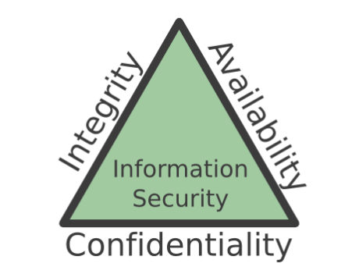
The Problem
Figuring out what security should focus on is difficult
Compliance requirements
Security frameworks
Vulnerability scans
Other assessments
Lots of facts, lots of opinions
Notes:
With so much content and opinions on how to do security “right”, it is difficult to find a good starting point, let alone something that helps move your company forward. It is easy to fall victim to analysis paralysis.

Slide 6

MITRE ATT&CK
Adversarial Tactics, Techniques, and Common Knowledge
Focus is on actionable detection techniques
Given common adversarial methodologies
Framework is high-level enough to report on and adapt
Yet specific enough to provide actual items to look for
Often indirectly solves other frameworks

Slide 7
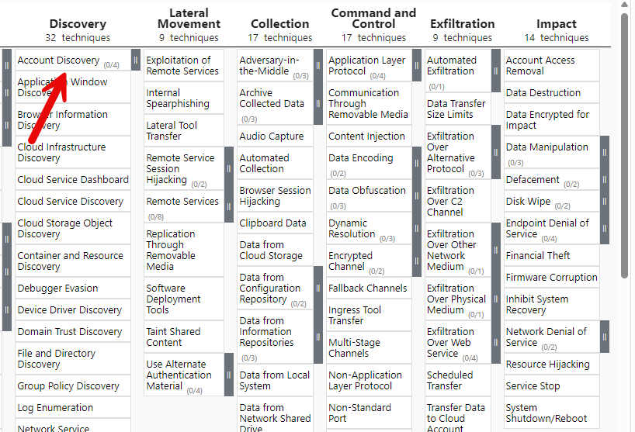
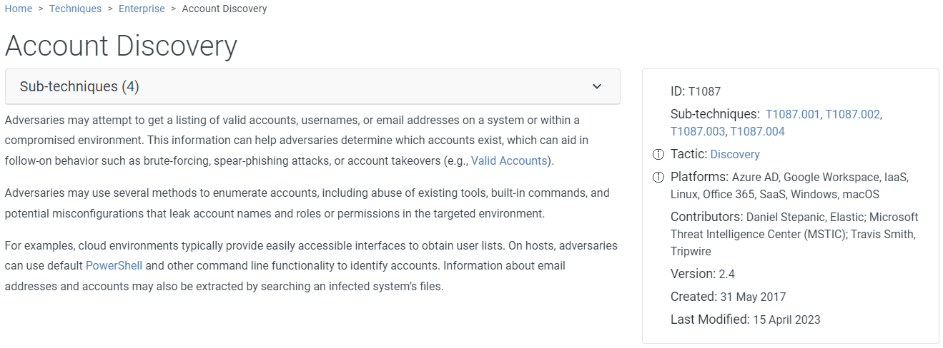
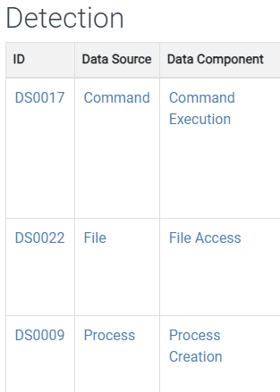
MITRE ATT&CK Enterprise

Slide 8
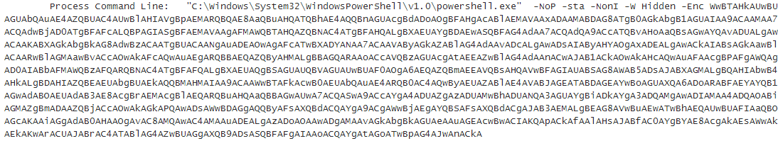
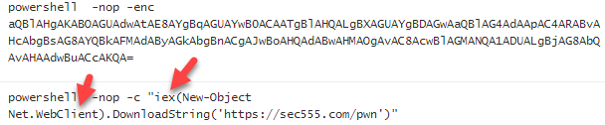
PowerShell Attacks (Event ID: 4104 or 4688)
PowerShell is now commonly used for modern attacks
This one command-line call could trigger over 20 different known MITRE techniques
Monitoring requires data visibility and detection capabilities

Slide 9
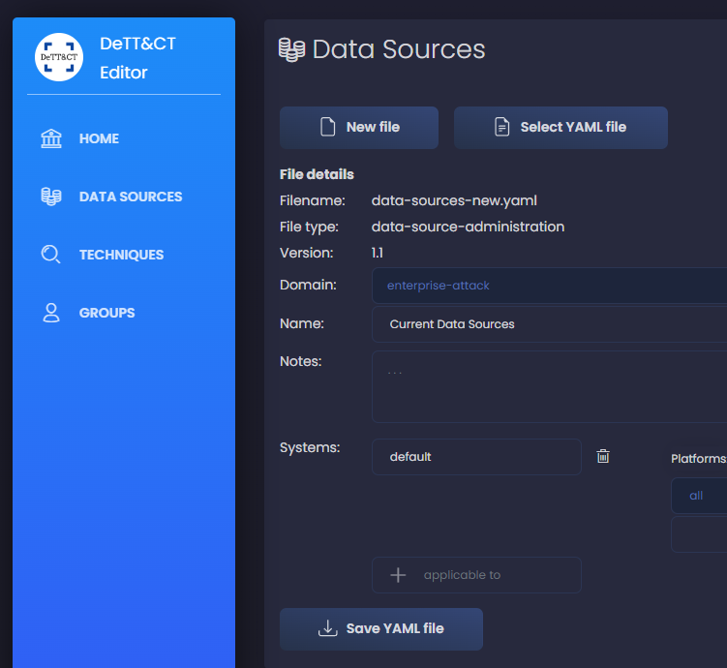
MITRE Mapping via DeTTECT
DeTTECT is an open-source framework to manage, assess and compare the quality of data sources, visibility, detection and threat actors
Consists of a Python tool, YAML administration files and a built-in web-based editor

Slide 10
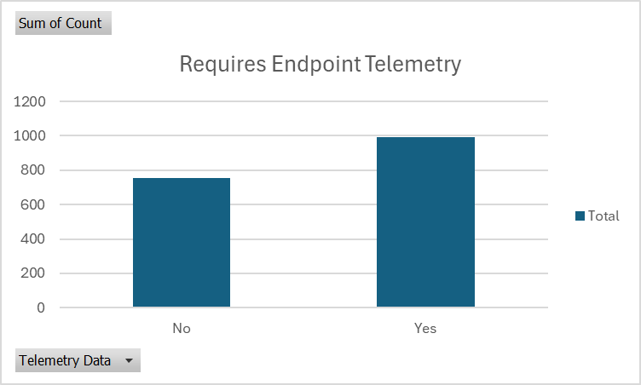
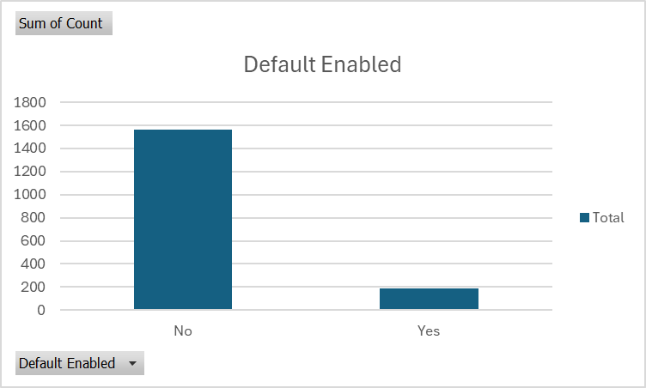
MITRE Technique Coverage by Data Source | MITRE DeTTECT
Example output from: python dettect.py generic –ds
Count Data Source
--------------------------------------------------
255 Command Execution
206 Process Creation
98 File Modification
88 File Creation
82 Network Traffic Flow
OS API Execution
70 Network Traffic Content
58 Windows Registry Key Modification
58 Network Connection Creation
55 Application Log Content
50 Module Load

Slide 11
Step 1 – Current State
The initial step is to measure your visibility today
Done by building a mapping file of current data sources
Use MITRE DeTTECT or any commercial integrations
Reference attack.mitre.org/datasources/ for more info
Discussion point
What can you communicate with this data?

Slide 12
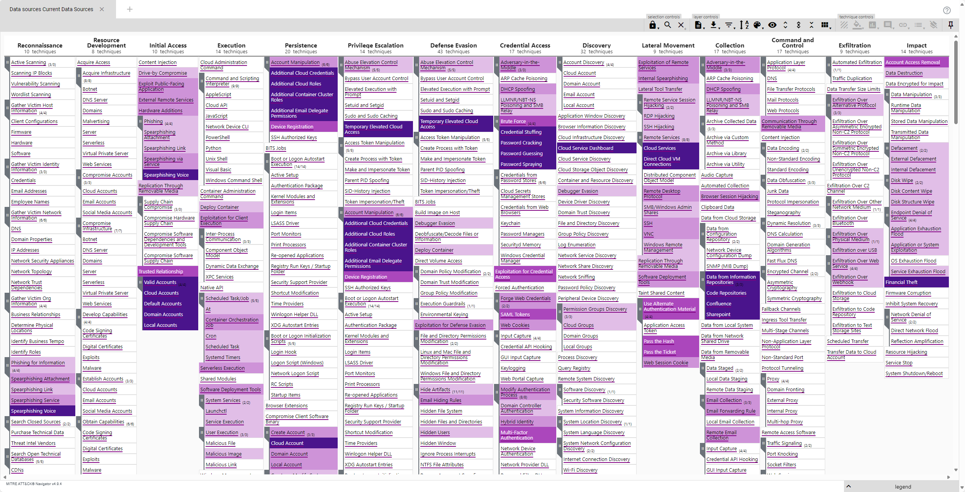
Windows Default Logging Level
*~11% 3/24
Notes:
The default Windows logging covers around 11% of known MITRE techniques as of 3/24. This percentage is the subject of argument as some logging may be enabled by default but not collected by default. For example, many logging agents on Windows often collect Application, System, and Security logs.

Slide 13
Step 2 – Identify Necessary Missing Data Sources
Initial visibility often can have drastic improvements with the additional of a few key data sources
Quick wins = High count techniques by data source
Focus on ease of deployment
Tell a story for justification
Purchase free examples:
Microsoft Sysmon/Auditd
PowerShell Logging
Commercial examples:
Endpoint Detection Response
Note: Prevention included but log telemetry often is additional cost
Alternatives:
Tuned built-in audit policies
Default + QW > 70% coverage
Notes:
Fortunately, there are a few things that often dramatically increase an organizations overall visibility. For example, installing Microsoft Sysmon and collecting the Sysmon logs adds another 56.84% MITRE coverage as of 3/19/2024. In fairness, this does not necessary mean that 56.84% of all MITRE techniques are fully covered, but it does mean that 56.84.% of MITRE techniques have at least some coverage. Default Windows logging only covers 10.59% of MITRE techniques. Default logging plus Sysmon changes this to 67.43% of techniques now with some level of coverage. This percentage can further increase with PowerShell logging.

Slide 14
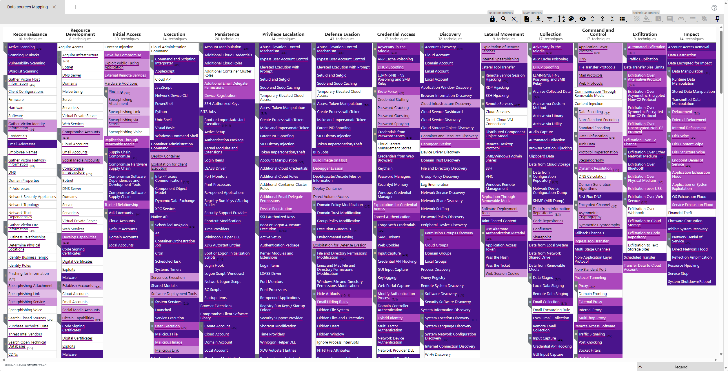
Default + Simple Additions (Telemetry/Sysmon/PowerShell)
*~80% 3/24

Slide 15
Step 3 – Build Mapping for Detection Capabilities
Mapping out detection capabilities is slightly different
REASON – Rules are stored in different formats
Goal is to extract MITRE techniques mapped to rules
Some tools have native export or visualizations
Others require basic scripting to extract and visualize
Depending on volume, may be possible to manually map
Security Information Event Management (SIEM) often records MITRE techniques per detection rule

Slide 16
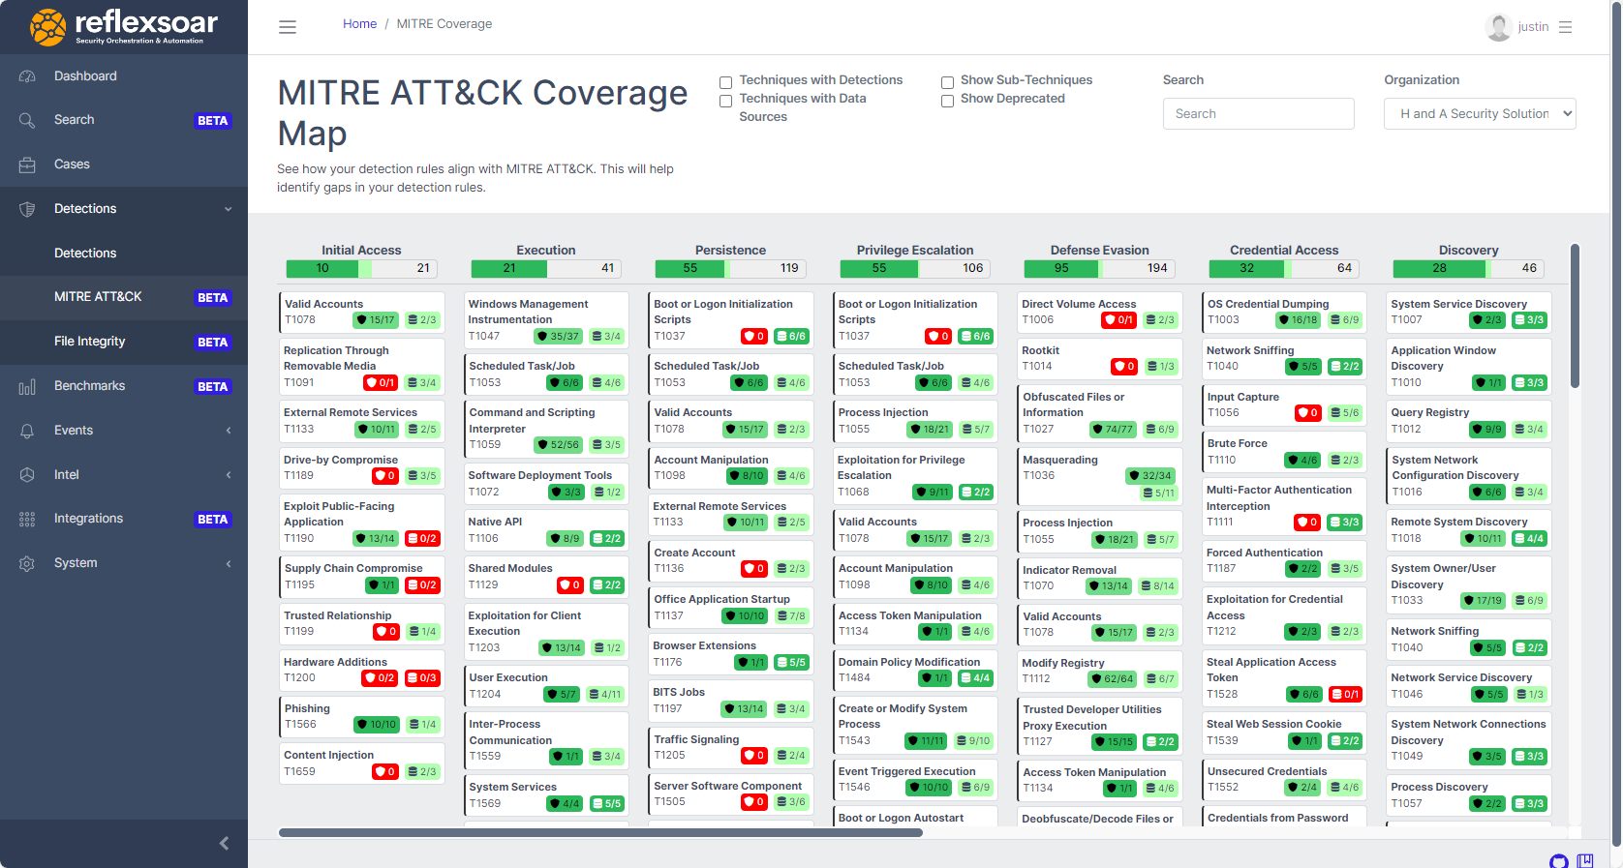
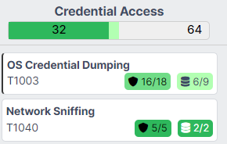
Commercial and Open-Source Integration with MITRE
Notes:
Nowadays there are multiple open-source and commercial tools and integrations to make mapping against MITRE ATT&CK and other frameworks a more simplified experience.

Slide 17
Step 5 – Identify Gaps (Step 4 coming on next slide)
The next step is to look for key gaps
MITRE Navigator allows comparing tabs together
Keep into consideration things like audits and compliance
How do you decide what to prioritize?
Where do you have visibility but no detection?
Where do you have detection without visibility?
Where are you missing both?

Slide 18
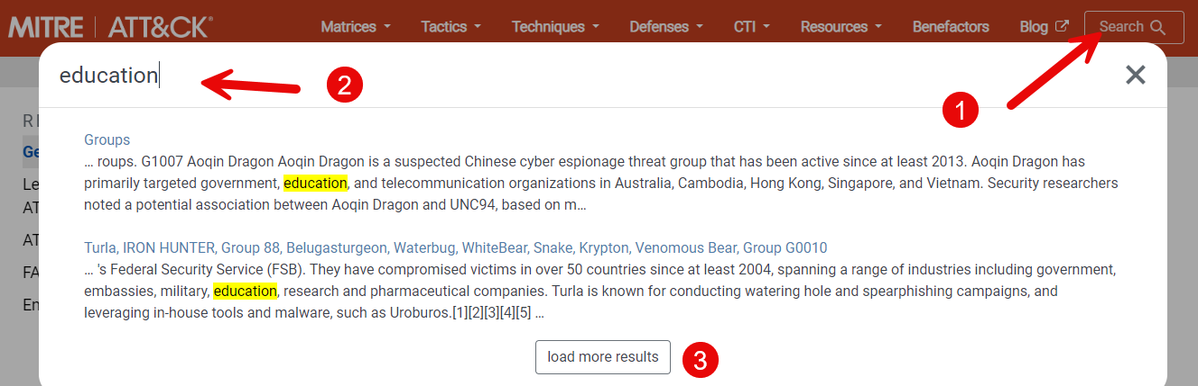
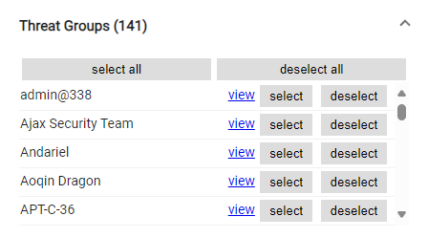
Step 4 – Tell a Story
Build a navigator file using attack.mitre.org search results
Search your industry
Add to navigator
Search groups and add score
Advanced: Add group per tab then combine

Slide 19
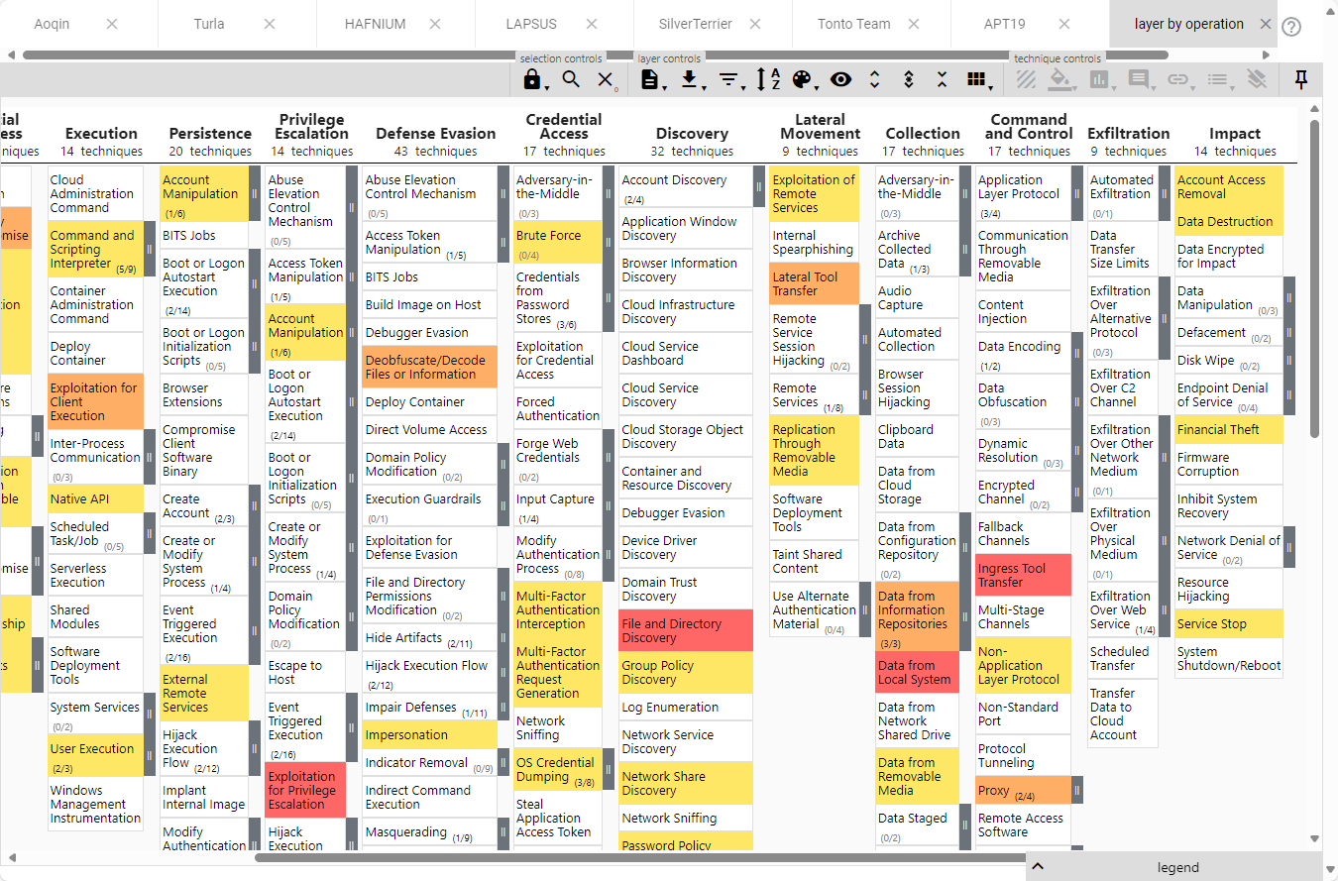
Industry Threat View
Navigator can easily show industry specific threats. Helpful for:
Comparing visibility, detection, and threats together
Prioritizing identified gaps

Slide 20
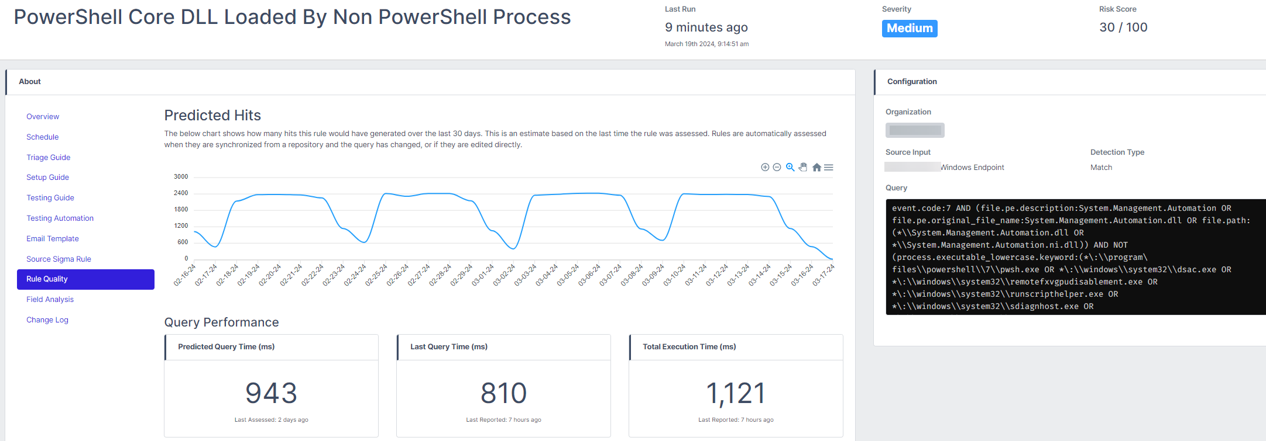
Step 6 – Stage New Detections
Pre-evaluate new rules before turning them on
Notes:
It is also worth considering evaluating rules again on updates to the query being performed.

Slide 21
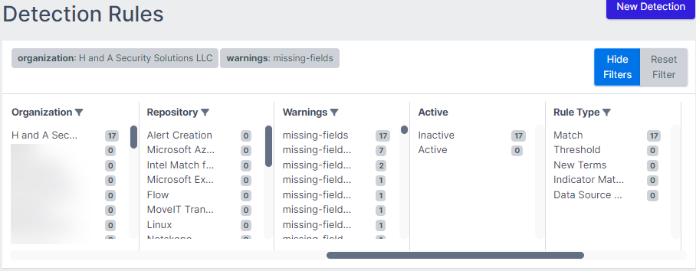
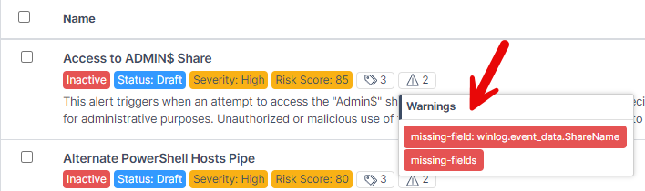
Look for Broken Detections

Slide 22
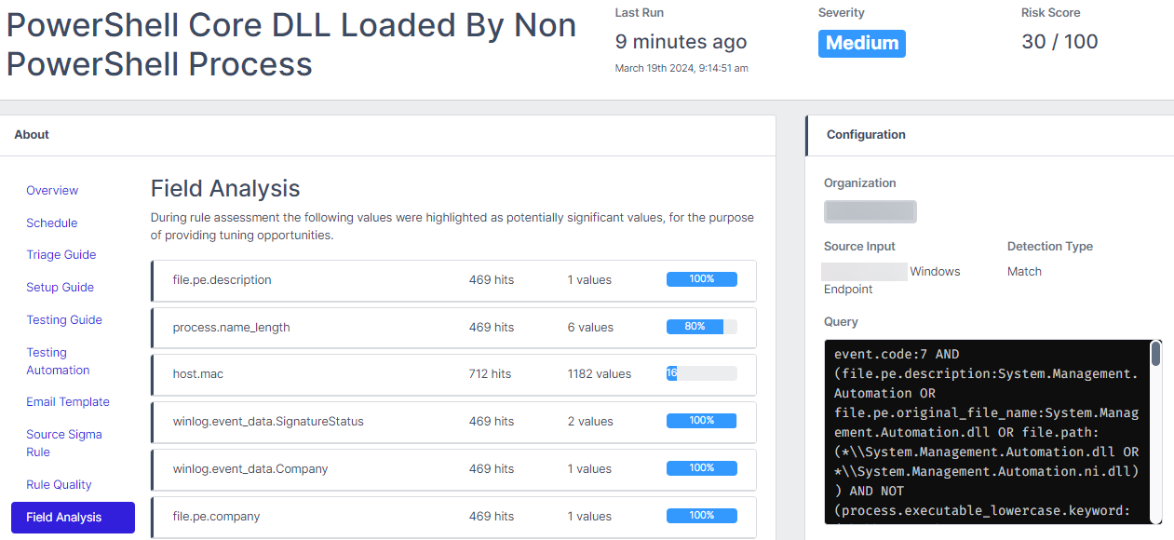
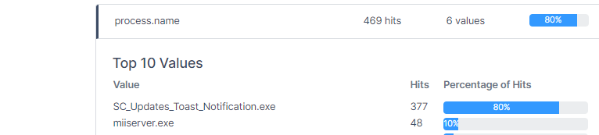
Save Analyst Time – Evaluate Alerts for Tuning Recommendations
Find ways to analyze rules that fire
What common fields and values are there
This simplifies adding exclusions
And finding poorly written rules

Slide 23

Six-Step Security Lifecycle
The steps are intended to be a continuous lifecycle
Identify current state
Build data source visibility map
Build detection coverage map
Identify threats
Identify gaps to address
Add visibility and stage new detection rules
Initial cycle takes time
Then it gets easier to repeat

Slide 24
Negative Filtering
If there were a step 7, it would be negative filtering
Involves finding gaps where you “show” coverage
Example: Visibility shown in MITRE Navigator, but certain assets do not exist in monitoring solutions
Negative filtering is often skipped which gives a false sense of coverage
Compare assets in Active Directory or asset management versus assets in monitoring solution
What is missing? Report and fix.

Slide 25
Data Begets Data
As more visibility is available, additional detection capabilities should be explored:
Process creations
Network connections
PowerShell logs
Commercial and Free detection rules are not specific to your organization
Simple analysis of captured data allows for rule creation

Slide 26
Organization Specific Monitoring of Process Creation
Use Case #1 – Unauthorized remote access tools
One way to access is searching for how many remote applications are running and check if it matches company policy
process.name_lowercase:(teamviewer.exe OR anydesk.exe OR radmin.exe OR vnc.exe OR logmein.exe OR remotepc.exe OR splashtop.exe OR chrome_remote_desktop_host.exe OR mstsc.exe OR psexec.exe OR ssh.exe OR putty.exe OR winscp.exe OR mremoteng.exe OR mobaxterm.exe OR tightvnc.exe)
How many are running?
What versions? Are those versions vulnerable? Expand to other software

Slide 27
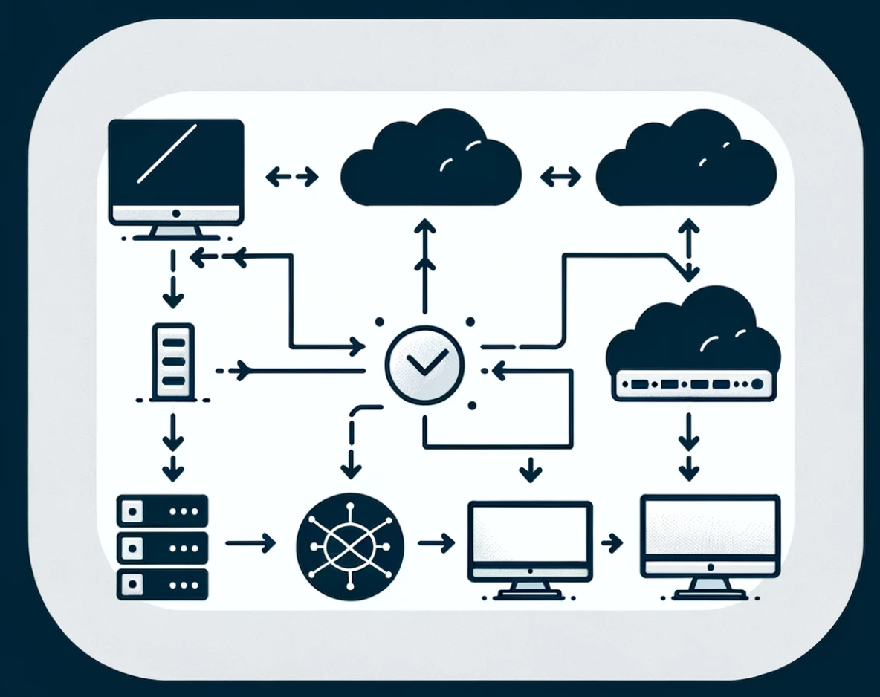
Organization Specific Monitoring of Network Connections
Use Case # 2 – What user, what process, what direction?
Endpoint network connections include user, process, and destination information
What applications should reach out to the internet?
What applications are allowed to connect to critical assets?

Slide 28
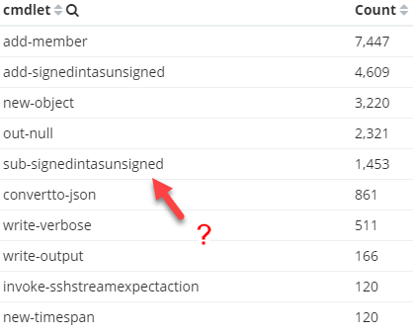
Organization Specific Monitoring of PowerShell
PowerShell cmdlets can be extracted and analyzed per user
Certain activity should only come from service accounts or admins
Example: Invoke-Command
Many assets have a finite list of cmdlets that run
Example: Common workstations and laptops

Slide 29
Thank you
Hopefully, this presentation provides you take home action to:
Identify current and future monitors states
Evaluate gaps and prioritize them
Learn new methods for evaluating rule sets
Use data to map to organization specific conditions
Questions?
info@hasecuritysolutions.com
Or see me at the H&A Security booth

